Slide 1
Introduction in time series
Definition :
A time series is a sequence of data points collected or recorded at successive time intervals, often at regular intervals like daily, monthly, or yearly. These data points are ordered chronologically, making time a critical variable in the analysis.
Time series data can represent various types, such as: stock prices, weather patterns, sales figures, or heart rate measurements
Examples of Time Series Data:
1. Stock Prices
2.Wheather Data

Slide 2
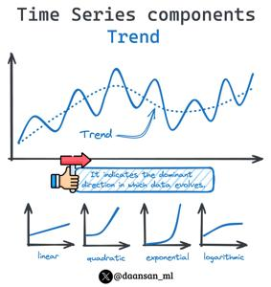
Trend Component
Trend: Represents the long-term movement in a time series, showing an overall increase or decrease over time. It can be linear or nonlinear and is often influenced by economic growth, technological advancements, or demographic changes.

Slide 3
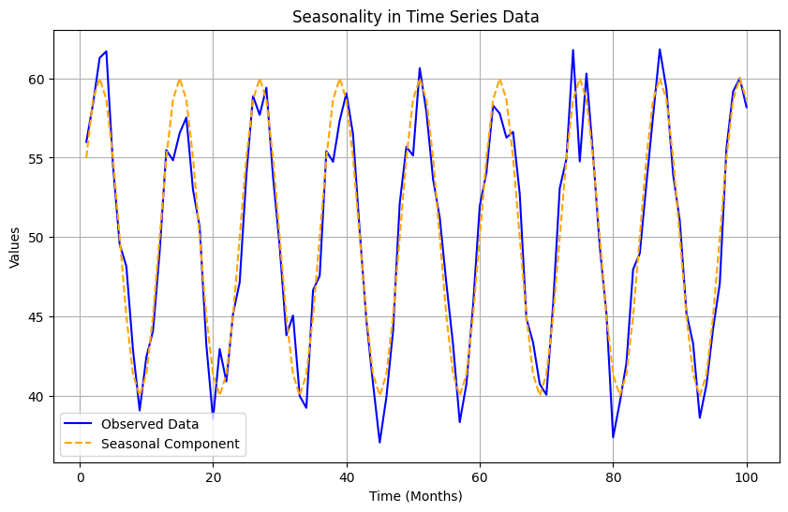
Seasonality Component
Seasonality: Refers to periodic fluctuations occurring at regular intervals (e.g., daily, monthly, or annually). These variations are caused by factors such as climate, holidays, or business cycles. For example, retail sales often peak during the holiday season.

Slide 4
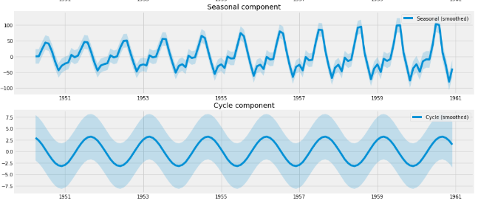
Cyclical Component
Cyclical Movements: Represent fluctuations that occur over a longer period, typically beyond a year, due to macroeconomic conditions such as business cycles. Unlike seasonality, cyclic patterns do not have a fixed period and are influenced by economic expansions and recessions.

Slide 5
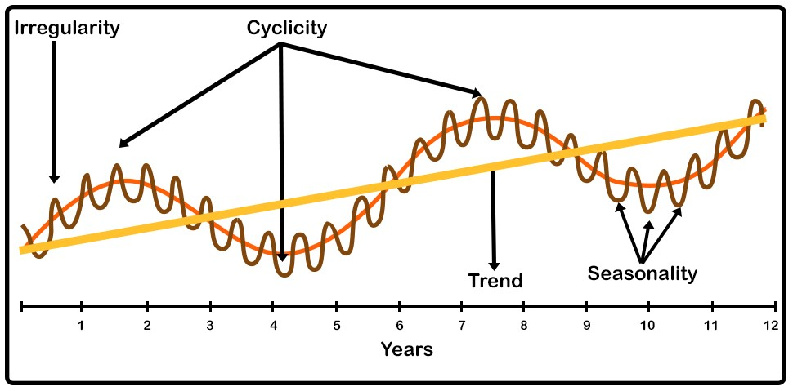
Irregular Component
Irregular Variations: Also known as random or residual variations, these are unpredictable changes caused by unforeseen events such as natural disasters, political instability, or sudden economic shocks. They do not follow any identifiable pattern and can distort trend, seasonal, or cyclical components.

Slide 6
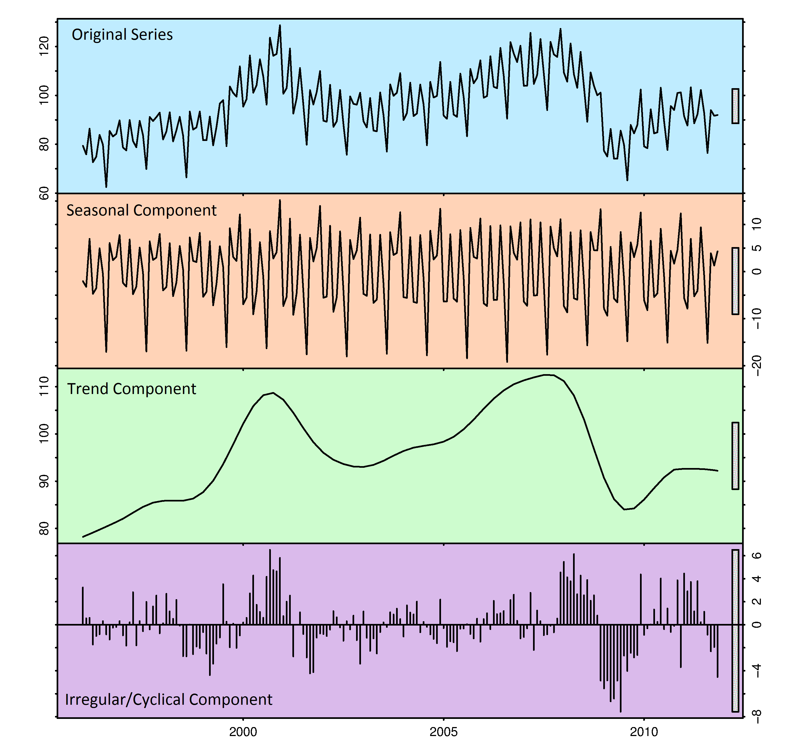

Slide 7
Tests Applied on Time series
1.Stionarity الاستقرارية
2.Causalityالسببية
3.Cointegrationنماذج التكامل المشترك

Slide 8
1.Stationarity test
What is Stationarity in Time Series?
In Time Series Analysis, a time series is said to be stationary when its statistical properties do not change over time.
1.Constant Mean : Mean ≈ constant
2. Constant Variance : Variance ≈ constant

Slide 9
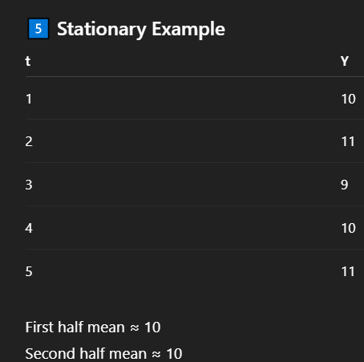
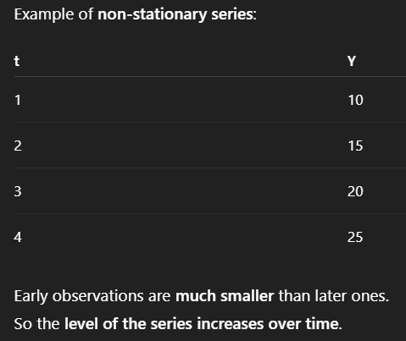
Example of Time series
Stationary series
Non Stationary series

Slide 10
Why and what is stationarity?
Stationarity Tests
Augmented Dickey-Fuller (ADF) Test – Checks if a time series has a unit root (non-stationary).
Phillips-Perron (PP) Test :
Similar to ADF but adjusts for autocorrelation and heteroskedasticity
Kwiatkowski-Phillips-Schmidt-Shin (KPSS) Test – Tests for stationarity (opposite of ADF and PP)

Slide 11
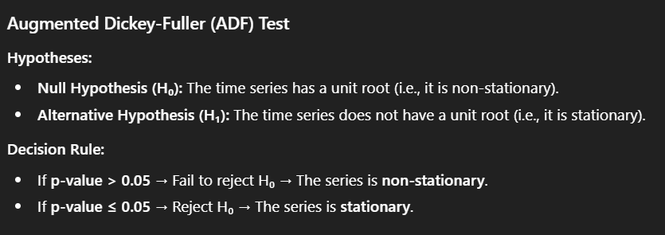
Stationarity Hypothesis In Time series
ADF_test

Slide 12
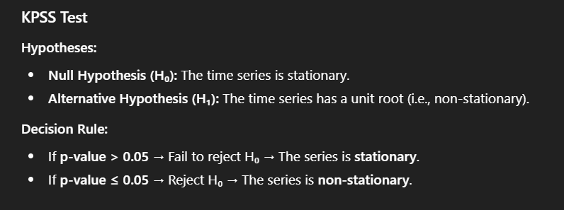
Kwiatkowski–Phillips–Schmidt–Shin test
Kpss_test

Slide 13
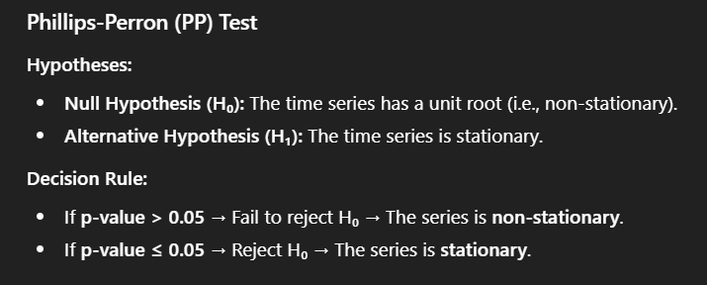
Phillips-Perron (PP) Test
PP_test

Slide 14
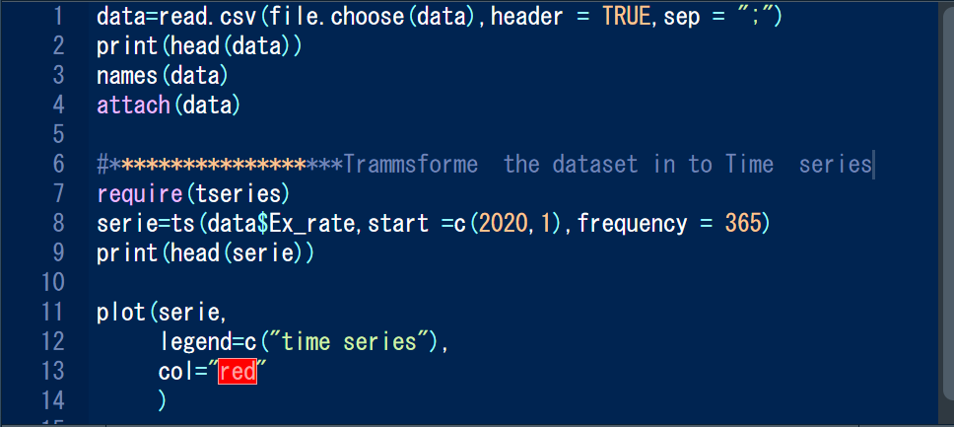
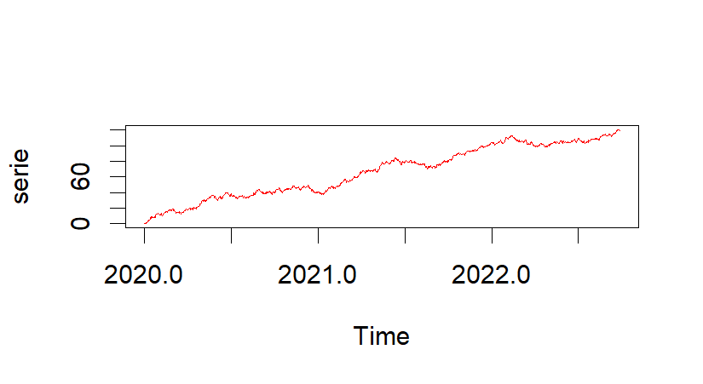
How to create series in R

Slide 15
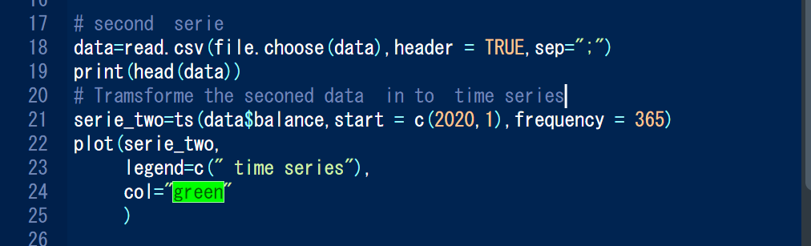
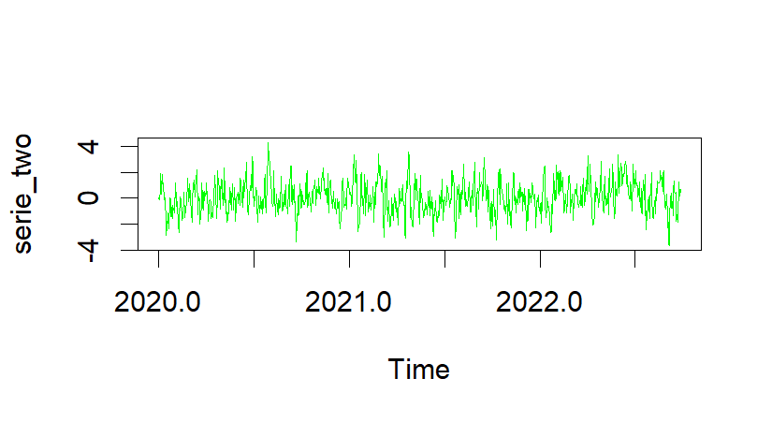
Stationary time series

Slide 16
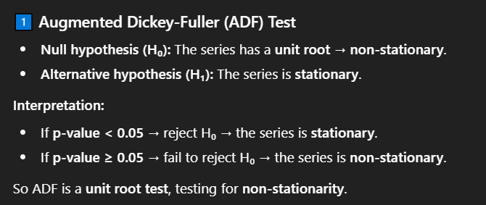
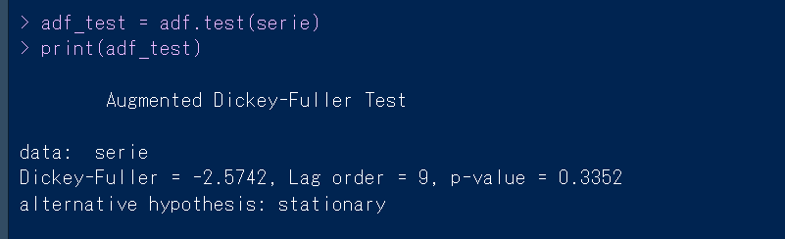
ADF_test

Slide 17
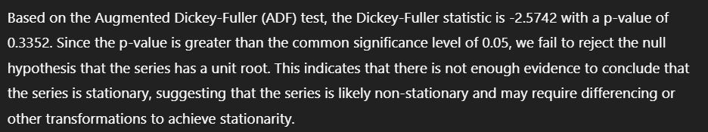

Slide 18
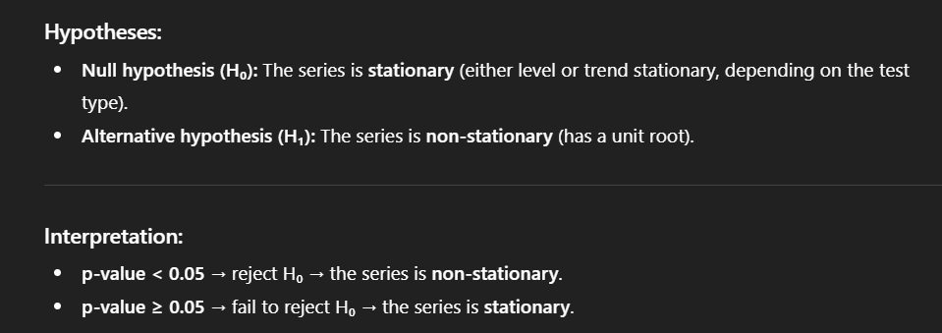
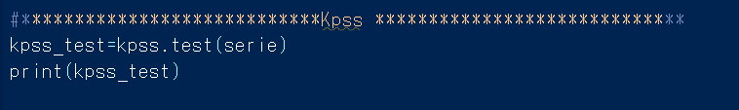
Kpss_test

Slide 19
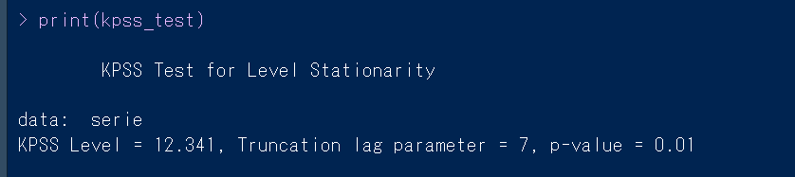
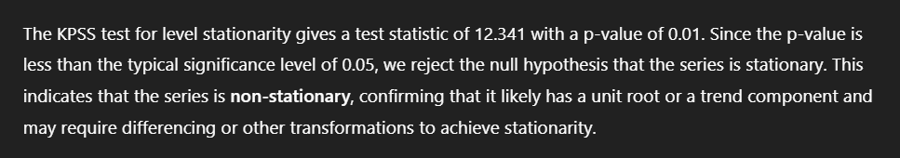

Slide 20
Transformation I time series
First Difference
log Correction
series d(series)
First Difference
log(series)

Slide 21
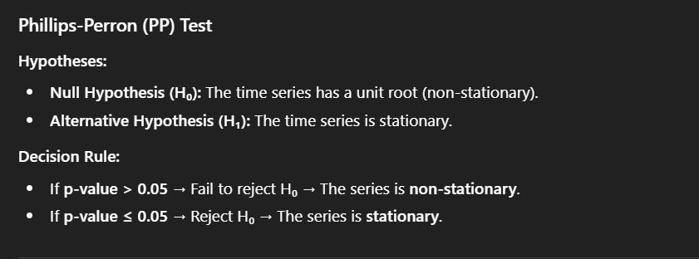
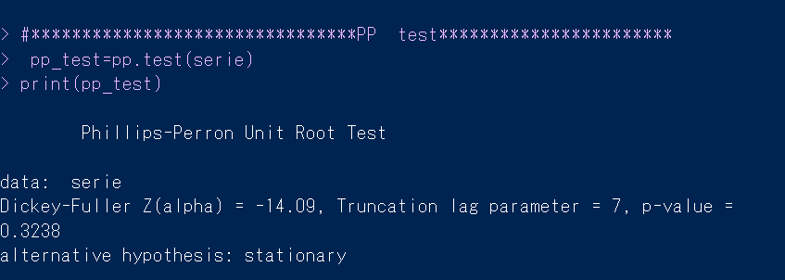
PP_test

